Slide 1

LIFE EXPECTANCY PREDICTION USING LINEAR REGRESSION - A Case Study By Imon Ghosh

Slide 2
OBJECTIVE
The dataset comprises of life expectancy, and other health factors for 193 countries. It has been collected from World Health Organization’s (WHO) Global Health Observatory (GHO) data repository .
We have considered data from year 2000-2015
The main objective of this study is to predict next year value of life expectancy using linear regression.
In regard to this objective, we are running a linear regression model on target variable life expectancy, to analyse the influence of several independent factors that affect the variable.

Slide 3
DEPENDENT VARIABLE – Life Expectancy
Life expectancy of a country, as we know, is a key metric for assessing population health.
We are trying to analyze which economic, social and health factors may affect a country’s life expectancy through multiple linear regression.
Our purpose is to examine the predictors that are significantly contributing to the dependent variable, i.e., life expectancy.
INDEPENDENT VARIABLES
The dataset comprises of 20 independent variables including Hepatitis B, Polio, Diphtheria, GDP, and several others. Country and Status are the only two categorical predictors, other predictors are numerical.
Also, in total, there are 2938 observations.

Slide 4
UNDERSTANDING THE RELATIONSHIP BETWEEN DEPENDENT AND INDEPENDENT VARIABLES THROUGH VISUAL REPRESENTATION

Slide 5
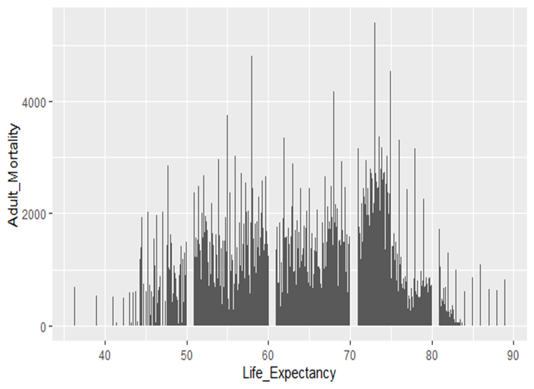
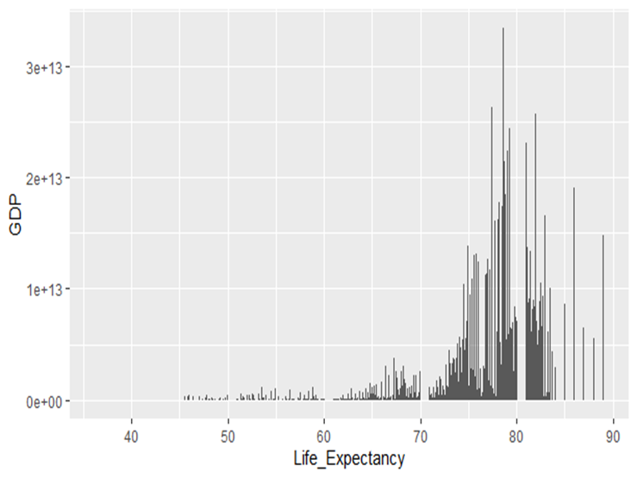
Both Adult Mortality and GDP of a country have a strong relationship with the dependent variable, life expectancy.

Slide 6
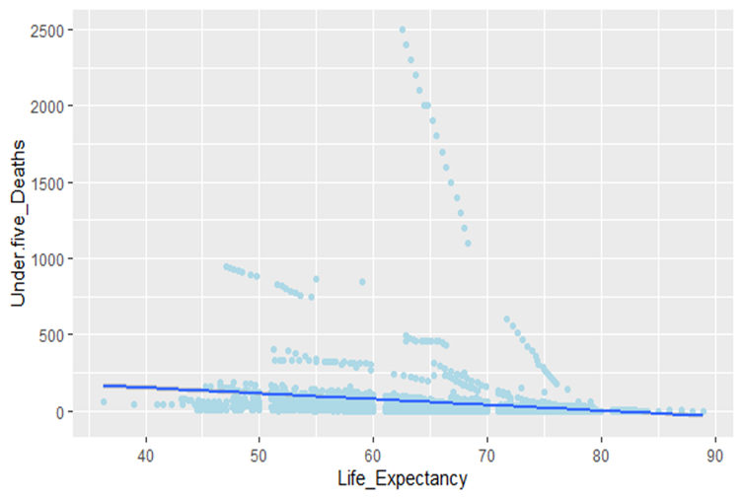
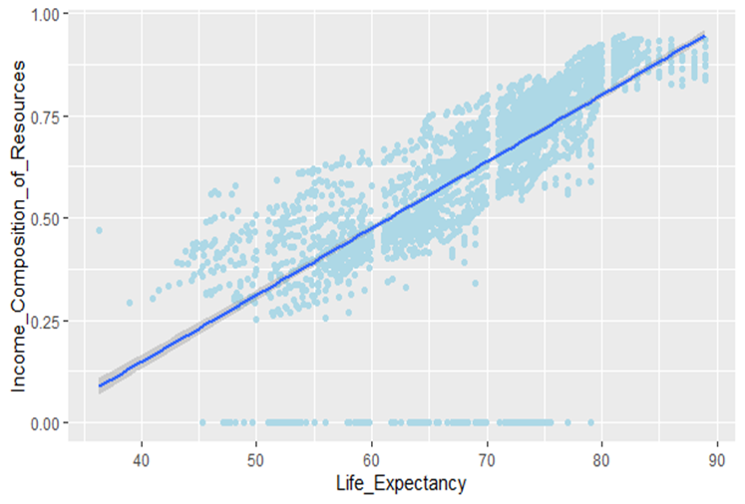
Clearly, an increase in Income Composition of Resources leads to improved life expectancy. However, declining Under five deaths results in better life expectancy of a country.

Slide 7
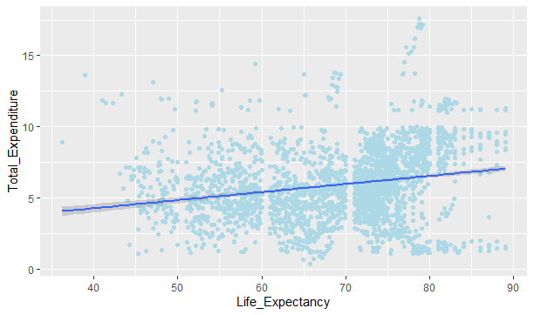
Although not a steep sloping line, it represents that total expenditure and life expectancy are somewhat positively related.

Slide 8
STATISTICALLY SIGNIFICANT VARIABLES
Here are the list of significant variables found after building the linear regression model:
Adult_Mortality
Alcohol
Percentage_Expenditure
Hepatitis_B
Measles
Total_Expenditure
Polio
HIV.AIDS
GDP

Slide 9
Income_Composition_of_Resources
Schooling
Diptheria
Status
Thinness_5.9_Years
Under.five_Deaths
Country
Year

Slide 10
STATISTICALLY INSIGNIFICANT VARIABLES
The following variables were found to be statistically insignificant:
Thinness_1.19_Years
Infant_Deaths
BMI

Slide 11
UNDERSTANDING HOW THE SIGNIFICANT VARIABLES CAN AFFECT THE DEPENDENT VARIABLE
Life expectancy at birth is largely affected adult mortality. Countries with higher adult mortality rates are more prone to experiencing lower life expectancy, as the longevity of people are lower in those countries.
Since higher levels of alcohol consumption can lead to hear and liver diseases, the lifespan of people are reduced significantly. This can in turn lead to shorter life expectancy.
A higher proportion of expenditure on health to improve the health status can significantly improve the life expectancy of the population of a particular country. Hence, both Percentage_Expenditure and Total_Expenditure are significant variables.
Hepatitis_B, Polio, Measles, HIV.AIDS, Diptheria, Thinness_5.9_Years and Under.five_Deaths are some of the popular health indicators that can negatively impact the life expectancy of a country. These illnesses can lead to shorter life expectancies.

Slide 12
Income composition of resources has a strong connection with life expectancy as if a country utilizes its resources productively, it is more likely to see its citizens live longer than expected.
Similarly, Schooling is an important component as the number of years people spend learning in school can increase their life expectancy by increasing the ability to obtain crucial information concerning health.
Higher Per capita GDP implies improved health, reduction in poverty, lower rates of mortality and therefore, higher life expectancy.
Lastly, life expectancy of a country is largely affected by the Population’s health and socio-economic development. As such, it significantly influences the dependent variables.
A country’s Status, i.e whether it is developed or developing can have a major impact on life expectancy. Because a developed country is more likely to have better economic growth and socio-economic development than a developing country. Hence, it could lead to prolongation of longevity of population, thereby leading to better life expectancy.

Slide 13
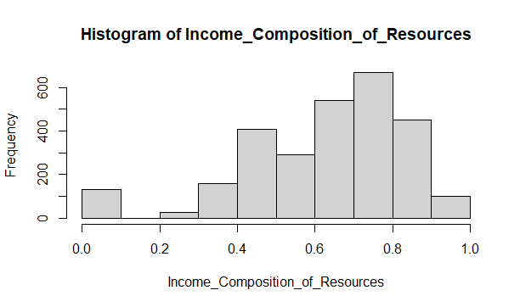
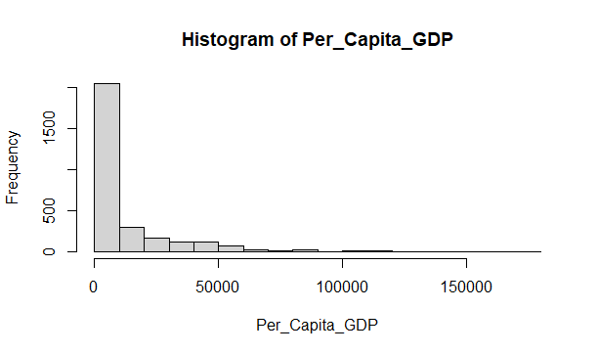
UNDERSTANDING THE SIGNIFICANT VARIABLES GRAPHICALLY

Slide 14
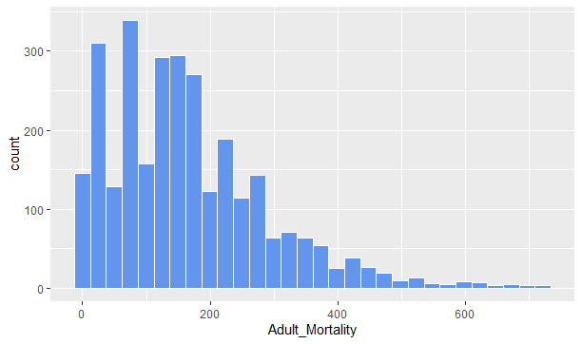
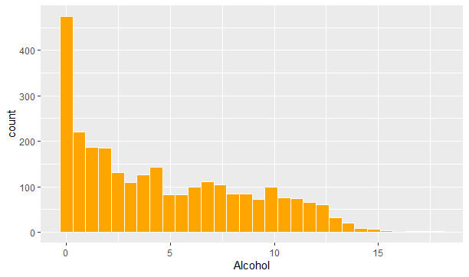

Slide 15
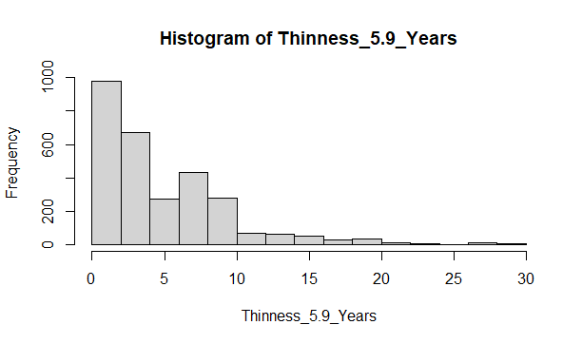
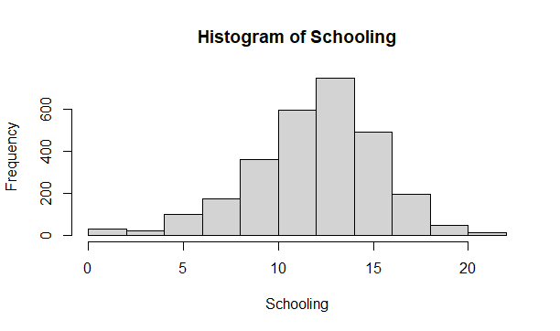
In the histograms shown above, tall bars show the common values of the variable, and shorter bars show less-common values.

Slide 16

RESULTS OBTAINED AFTER ANALYSIS
After removing all insignificant variables and running the linear regression model to predict life expectancy, the following results have been obtained –
Multiple R-squared: 87.1%, Adjusted R-squared: 87.02%
This represents the goodness of fit for the model. A higher adjusted R-squared indicates that the additional input variables are adding value to the model and improving the model fit.
Breusch-Pagan test for Heterescedasticity(checking outliers in the data set)
BP = 301.9, df = 19, p-value < 2.2e-16

Slide 17
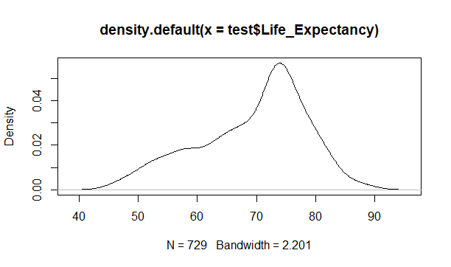
The BP test indicates that the error terms are normally distributed. After using the boxplot, we see that there is no heteroscedasticity present in the model.
Anderson-Darling normality test: A = 11.13, p-value < 2.2e-16

Slide 18
The plot represents a bell shaped curve. So, the dataset is normally distributed.
Durbin Watson test for Autocorrelation:
DW = 0.69718, p-value < 2.2e-16
Since DW lies between 0 and 4, we can say that there is no autocorrelation present in the dataset.
Finally, mean absolute percentage error (MAPE) is one of the most popular measures of the forecast accuracy. In this study, MAPE = 0.04, which implies that the average absolute difference between the forecasted value and the actual value is 0.04%

Slide 19
VARIABLE RELATIONSHIPS
The following variables possess positive coefficients and hence can be called positive variables –
Year
Percentage Expenditure
Polio
Diphtheria
Total Expenditure
Per Capita GDP
Population
Income Composition of Resources
And the following variables possess negative coefficients and hence can be called negative variables –
Status
Adult Mortality
Alcohol
Hepatitis B
Measles
Under 5 Deaths

Slide 20

Thinness 5.9 Years
HIV-AIDS
Schooling
Status
Country
Year
GDP

Slide 21
CONCLUSION
The linear model in this analysis seems fit to predict life expectancy, based on the accuracy, the adjusted R-squared value, and the various assumption checks.
Since a country’s life expectancy depends on economic and social factors, to improve the life expectancy, it is important to improve the overall growth and development of the economy.
Also, more attention should be paid to build better healthcare system to improve the life expectancy of a country.

Slide 22
THANKS!

